Slide 1
Stack

Slide 2
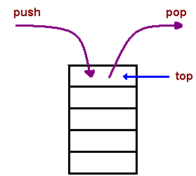
Stack
A stack is an Abstract Data Type (ADT)
A stack is a container of objects that are inserted and removed according to the last-in first-out (LIFO) principle

Slide 3
Stack
A stack can be implemented by means of Array, Structure, Pointer, and Linked List.
Applications
Reverse a word
You push a given word to stack - letter by letter - and then pop letters from the stack.
"undo" mechanism in text editors
this operation is accomplished by keeping all text changes in a stack.
Backtracking (labyrinth or maze - how do you find a way from an entrance to an exit)

Slide 4
Stack
Applications
Language processing:
space for parameters and local variables is created internally using a stack
compiler's syntax check for matching braces is implemented by using stack.
support for recursion
Solving arithmetic expression (postfix expression)
https://www.tutorialspoint.com/data_structures_algorithms/stack_algorithm.htm

Slide 5
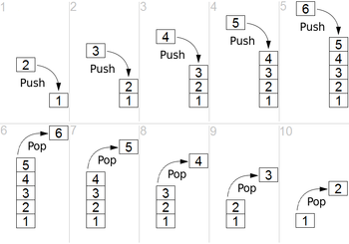
Stack
https://en.wikipedia.org/wiki/Stack_(abstract_data_type)

Slide 6
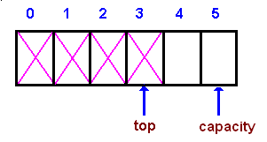
Stack
Array-based implementation
Push
The process of putting a new data element onto stack is known as a Push Operation.
Step 1 − Checks if the stack is full
Step 2 − If the stack is full, produces an error and exit
Step 3 − If the stack is not full, increments top to point next empty space
Step 4 − Adds data element to the stack location, where top is pointing
Step 5 − Returns success

Slide 7
Stack
Array-based implementation
Pop
Accessing the content while removing it from the stack, is known as a Pop Operation. In an array implementation of pop() operation, the data element is not actually removed, instead top is decremented to a lower position in the stack to point to the next value. But in linked-list implementation, pop() actually removes data element and deallocates memory space

Slide 8
Stack
Array-based implementation
Pop
Step 1 − Checks if the stack is empty
Step 2 − If the stack is empty, produces an error and exit
Step 3 − If the stack is not empty, accesses the data element at which top is pointing
Step 4 − Decreases the value of top by 1
Step 5 − Returns success

Slide 9
Stack: Linked list
https://www.cs.usfca.edu/~galles/visualization/StackLL.html

Slide 10

Stack: postfix expression
Infix Expression Prefix Expression Postfix Expression
A + B + A B A B +
A + B * C + A * B C A B C * +
A + B + C + D + + + A B C D A B + C + D +
A + B * C can be written as (A + (B * C)) ⇒ A B C * +

Slide 11
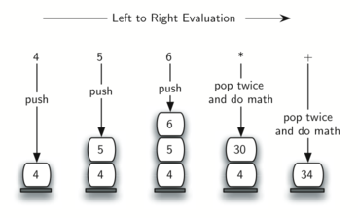
Stack: postfix expression
4 5 6 * +

